Slide 1
ГУ “Отдел образования города Кокшетау управления образования Акмолинской области”
Шапенова Гаухар Кабдешовна
учитель английского языка
Специализированной гимназии
№3 имени М.Габдуллина

Slide 2
TEACHING READING. KEY CONCEPTS.

Slide 3
What is reading?
Reading is one of the four language skills: reading, writing, listening and speaking. It is a receptive skill like listening.
Understand the language of the text at word level, sentence level or whole-text level. We also need to connect the message of the text to our knowledge of the world.
Look at this sentence:
The boy was surprised because the girl was much faster at running than he was.

Slide 4
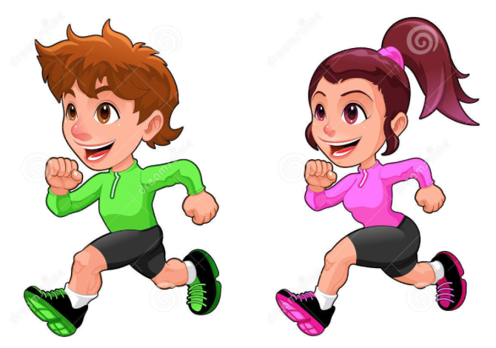
Reasons why learners may find reading difficult?
A text is usually longer than just a word or a sentence. It often contains a series of sentences, as in a letter or even a postcard. Connected text is referred to as discourse. Discourse is connected by grammar and vocabulary and/or our knowledge of the world. Reading involves understanding these connections.
For example: The boy was surprised because the girl was much faster at running than he was. But after he found out that her mother had won a medal for running at the Olympic Games, he understood.

Slide 5
Reading skills:
Reading for specific information (Scanning)
Reading for detail
Deducing meaning from context
Understanding text structure
Reading for gist (Skimming)
Inferring
Predicting

Slide 6
Reading in different ways according to the purpose of the task:
Scanning - read a text just to find a specific information in it
Reading for gist or skimming - also called reading for global understanding.
Reading for detail - getting the meaning out of every word and out of the links or relationships between words and between sentences, this skill is called intensive reading.
Inferring - to get meaning from a text, work out what the writer’s opinion on a topic is or what his/her feeling is.

Slide 7
Deducing meaning from the context involves reading the words around an unknown word or thinking about the situation the unknown word is used in to try and work out its meaning. For example, imagine you see a text in Portugal. You see this sentence: Lisboa e’ a capital de Portugal. You can probably deduce the meaning of Lisboa.
Predicting means using clues before we begin reading, to guess what a text may be about.

Slide 8
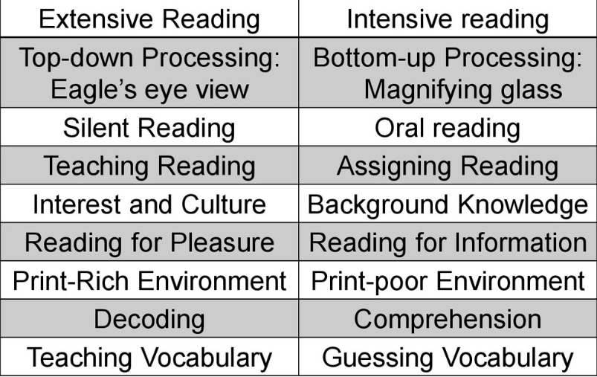
Reading
Extensive
Intensive

Slide 9
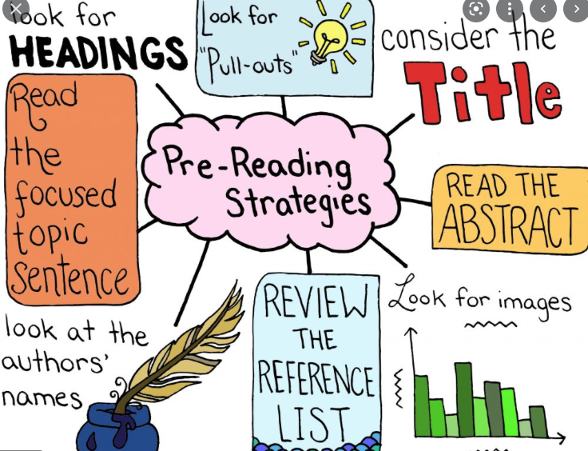
Teachers can check which reading subskills their learners are good at, then focus on practicing the subskills they are not yet using well. They can also help them by pre-teaching vocabulary,by asking learners to predict text content and with certain kinds of learner, encouraging them to predict text structure.
The teacher can do lead-in activities before the class look at the text. Lead-in activities generally involve looking at the picture around a text or at the title and trying to predict what the text will be about. They can also involve using brainstorming.

Slide 10
Giving learners lots of opportunities for extensive reading, in or out of class, helps them to develop their fluency in reading. Graded readers (books with language made easier for language learners) are very useful way of giving learners extensive reading practice, helping them build up confidence in reading and consolidate the language they know and gradually extend it to include new language.

Slide 11
Which reading skills we need to teach depends on the age and first language of the leaners.

Slide 12
Texts should be interesting in order to motivate learners. Texts should also be at the right level of difficulty. A text may be difficult because it contains complex (complicated) language and/or because it is about a topic that learners don’t know much about.

Slide 13
To make sure learners get used to a range of text types we can give them different kinds of texts to read, e.g. articles, stories, postcards, emails, brochures, leaflets, etc.
The activities in a reading lesson often follow this pattern:
Introductory activities:
Main activities:
Post-task activities: asking learners to talk about how the topic of the text relates to their own lives or to give their opinions on something in the text. These activities require learners to use some of the language they have met in the text.

